Slide 1
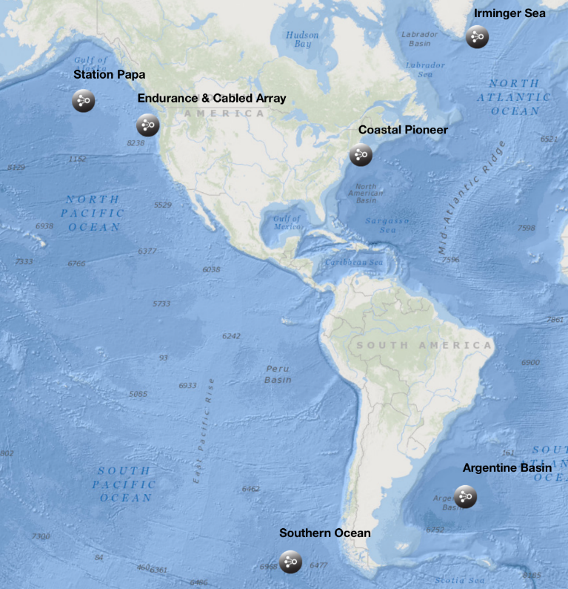
The Ocean Observatories Initiative: A short 3 hour overview
Michael F Crowley, M. Vardaro, L. Belabbassi, M. Smith, L. Garzio, F. Knuth, J. Kerfoot, S. Glenn, O. Schofield, S. Lichtenwalner..
Rutgers University, Dept. of Marine & Coastal Sciences, New Brunswick, NJ

Slide 2
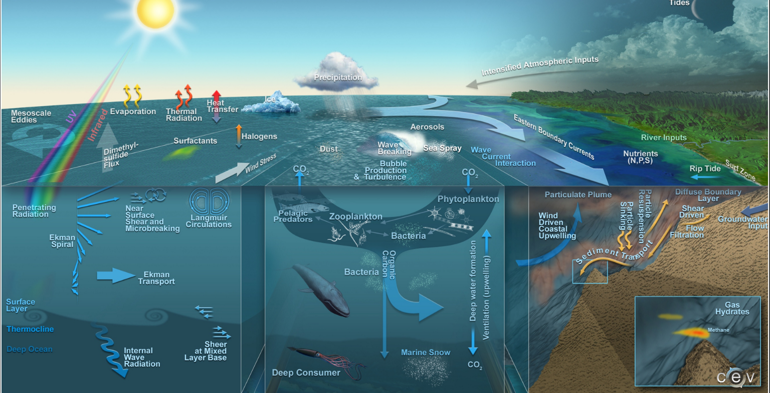
Why OOI?
Crossing time & spatial scales
Ocean-Atmosphere Exchange Climate Variability, Ocean Circulation, Ecosystems Turbulent Mixing and Biophysical Interactions Coastal Ocean Dynamics & Ecosystems

Slide 3
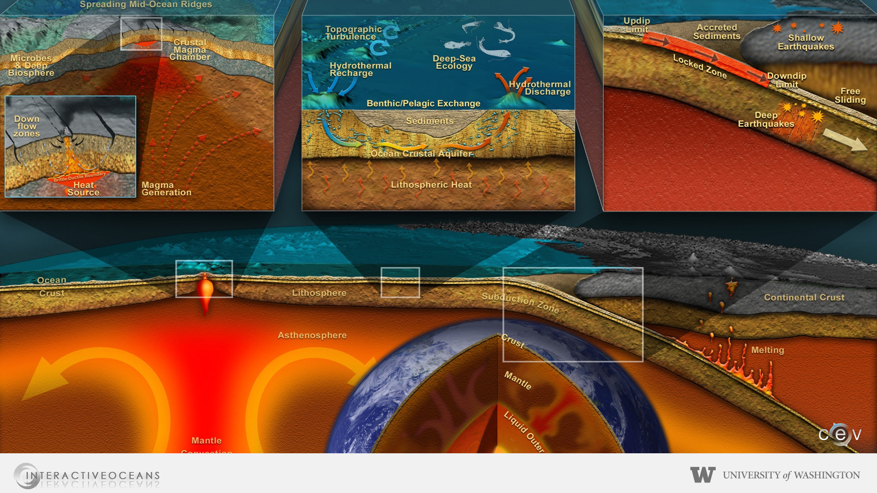
Why OOI?
Fluid-Rock Interactions & Sub-seafloor Biosphere Plate-scale Geodynamics

Slide 4
The Observatory

Slide 5
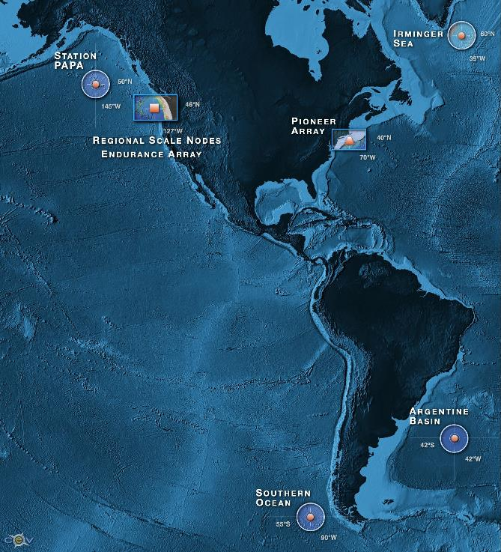
OOI By the Numbers
7
57
33
1227
>2500
>100K
Arrays
4 Global, Pioneer, Endurance, Cabled
Sites
Moorings, Profilers, Nodes
Mobile Assets
Gliders, AUVs
Instruments
Science Data Products
Science/Engineering Data Products

Slide 6
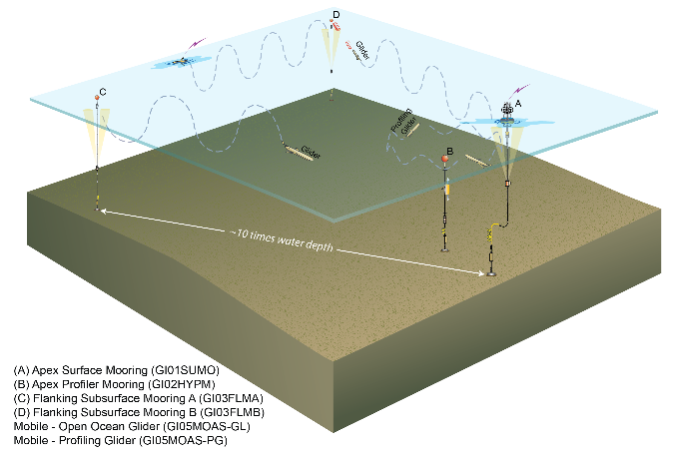
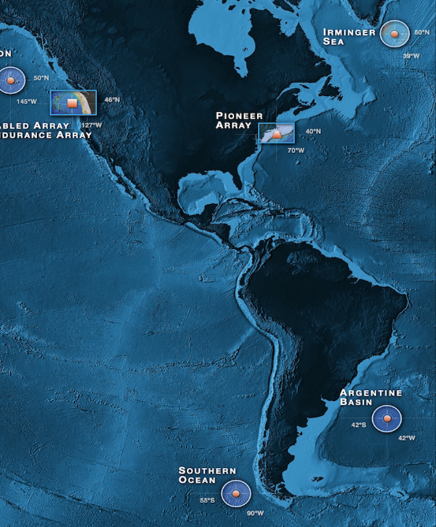
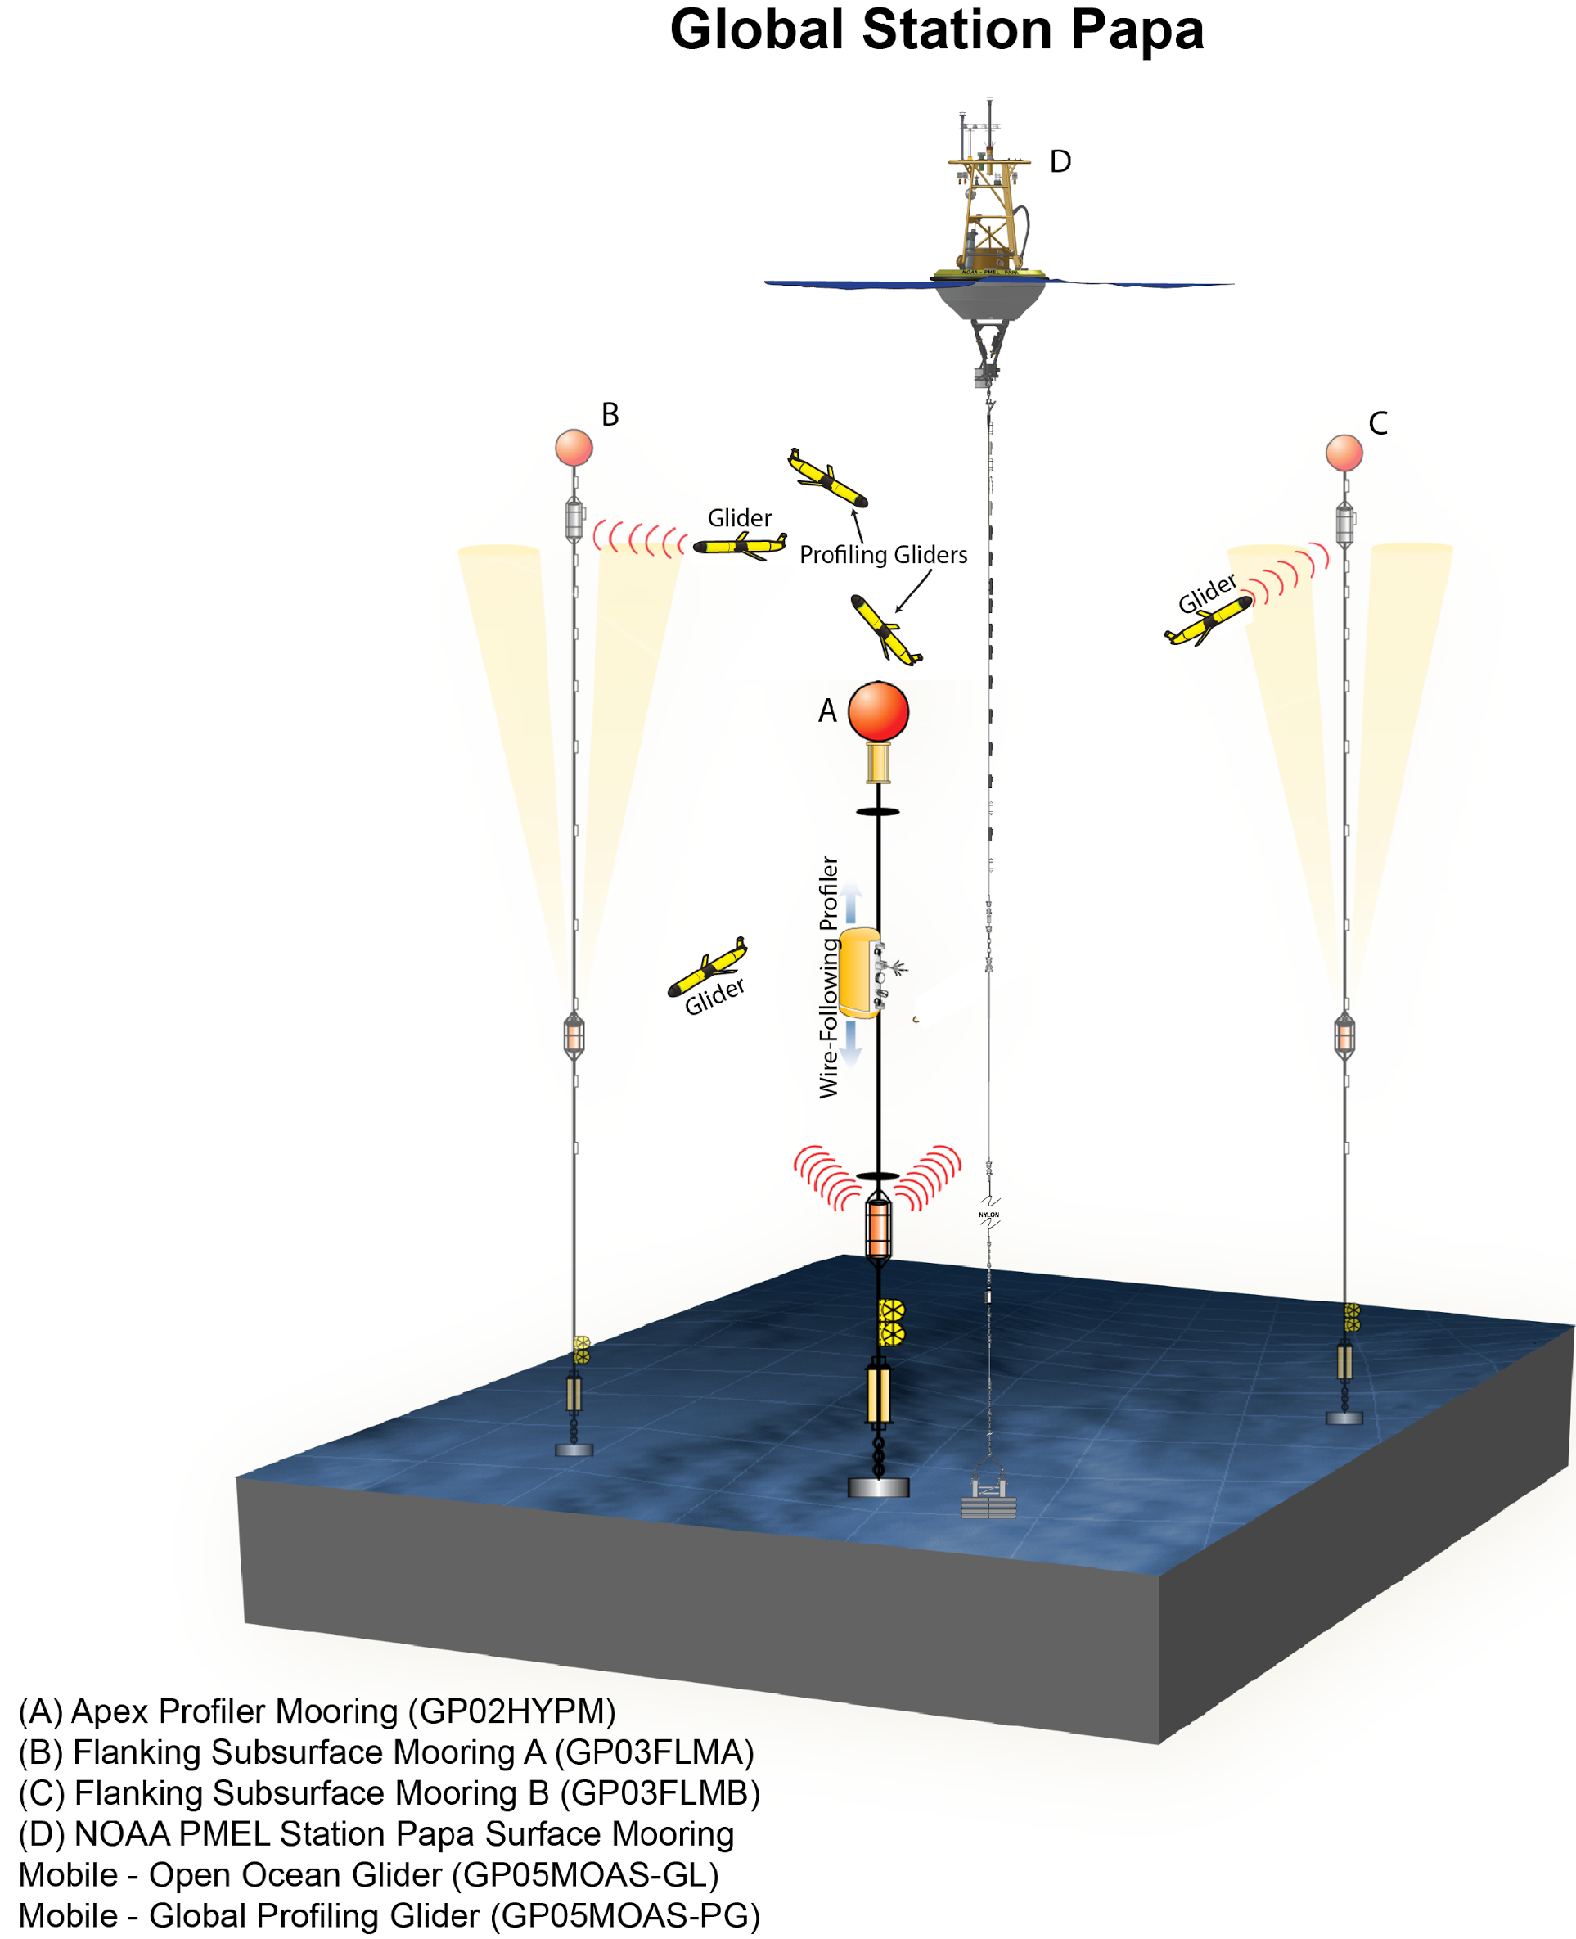
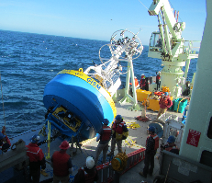
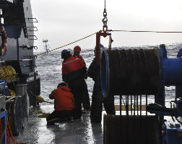
OOI Components: Global Array
Four Global Sites
Flanking Moorings
Profiler Mooring
Surface Mooring
Gliders (5)
Bio-Acoustics
Telemetered & recovered data

Slide 7
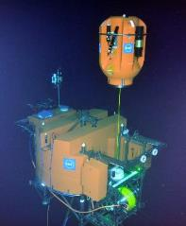
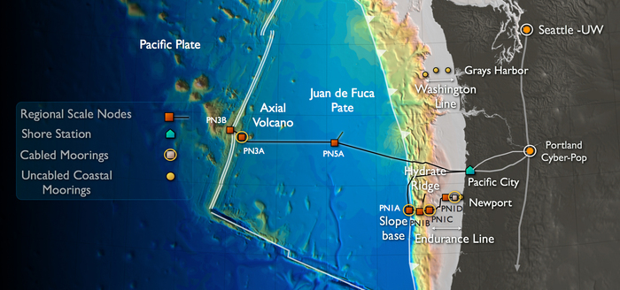
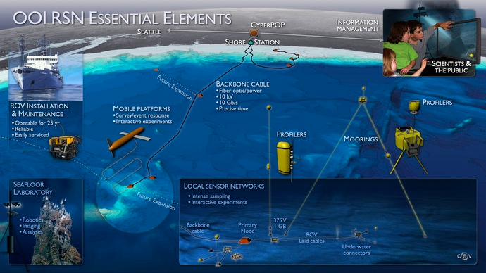
OOI Components: Cabled Array
Cable allows for high frequency sampling and quick delivery
Moorings
Profilers
HD Video
Hydrophones
Seismic

Slide 8
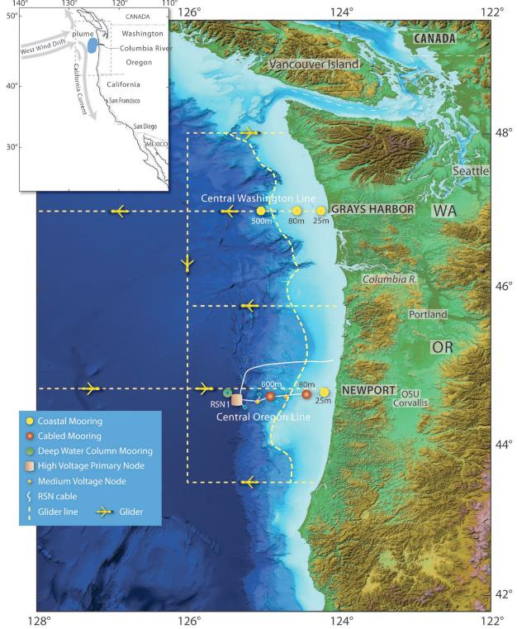
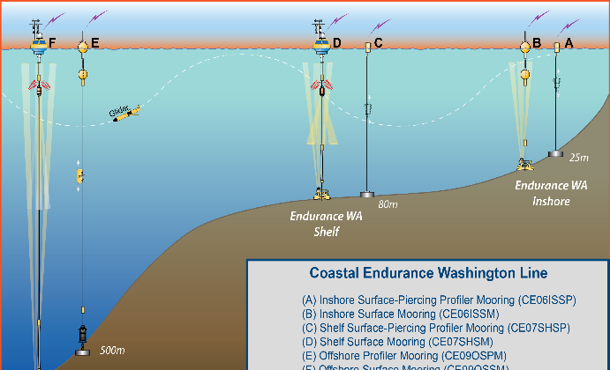
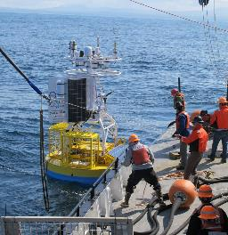
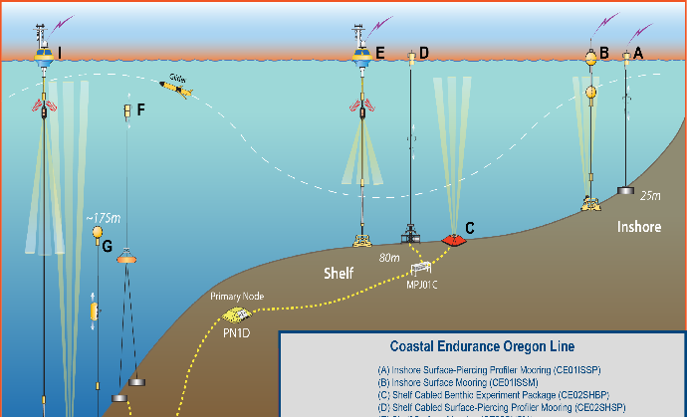
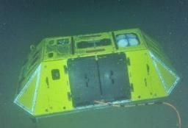
OOI Components: Endurance Array
Glider AUVs
Moorings
Profilers
Met Data
Telemetered & recovered
‹#›

Slide 9
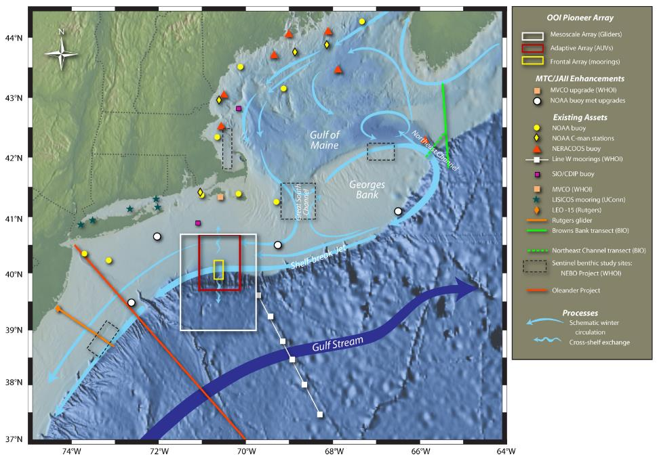
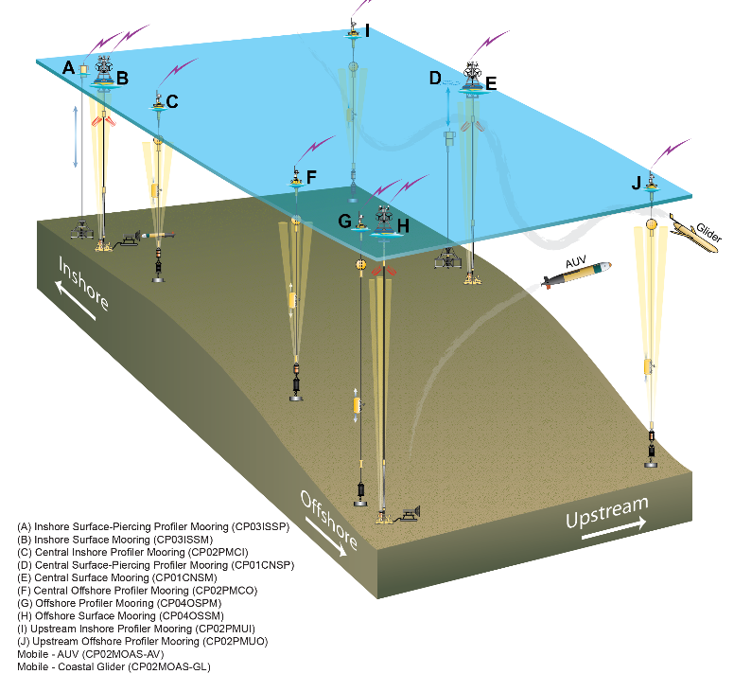
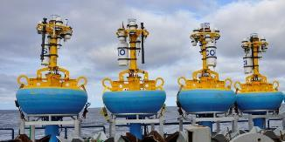
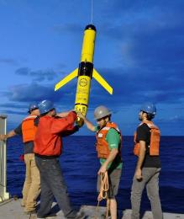
OOI Components: Pioneer Array
Glider AUVs
Moorings
Profilers
Met Data
REMUS AUV (late 2016)
Telemetered & recovered

Slide 10
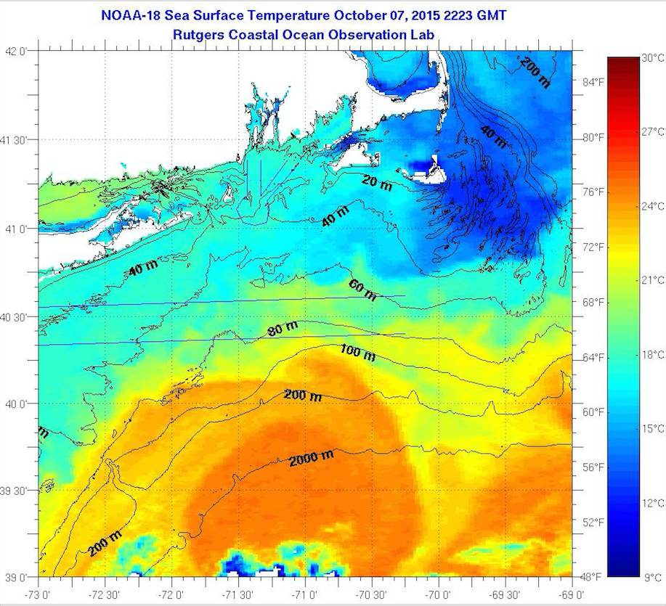
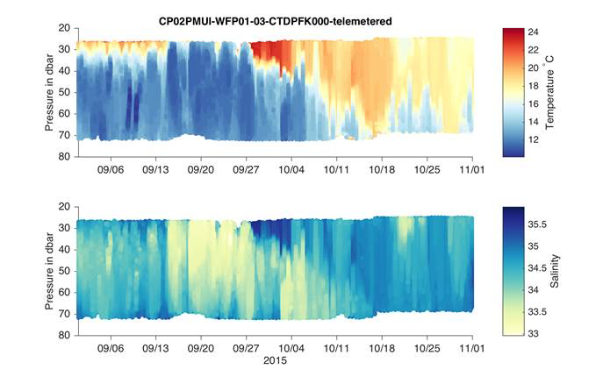
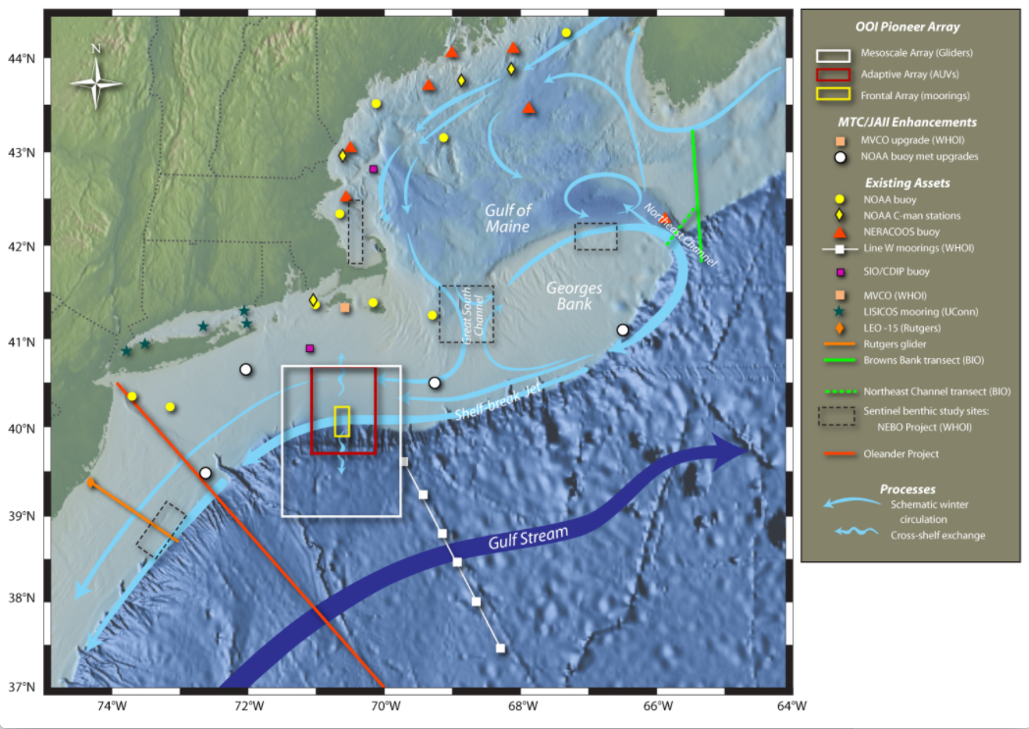
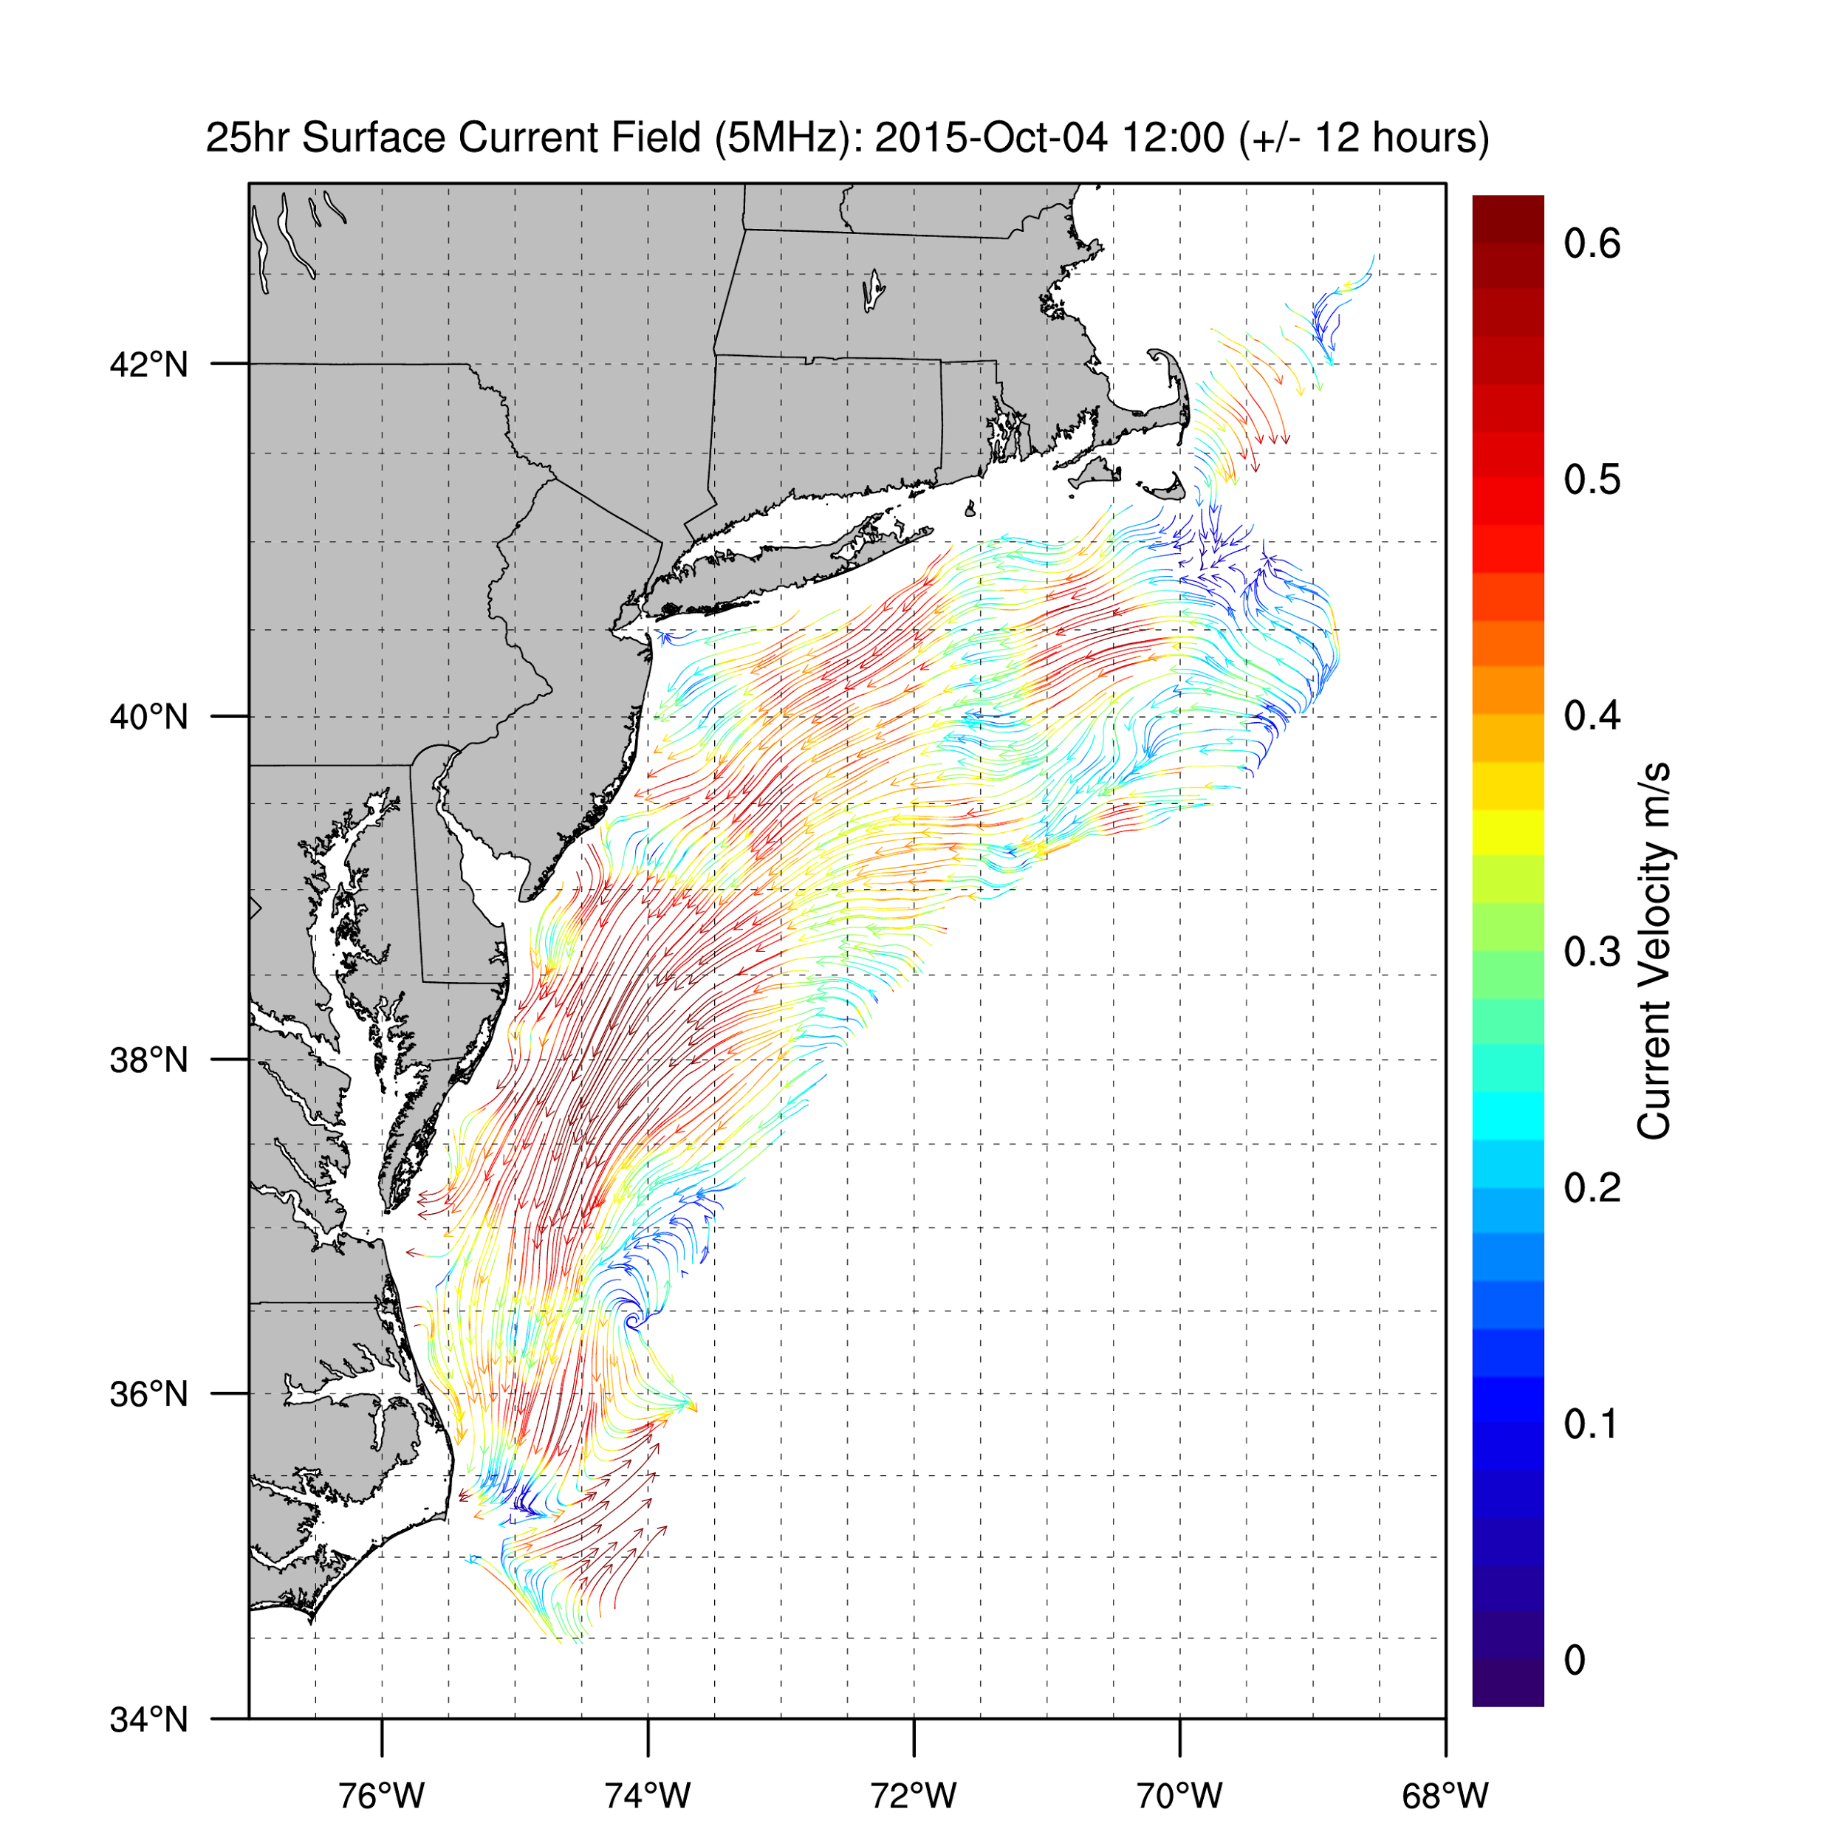
Science Evaluation: Are ocean features encountered real? Outside local range
Is this real?
Taking advantage of all assets, even non-NSF, to assess data quality
IOOS data shows presence
of warm core ring
IOOS data shows ocean response to storm

Slide 11
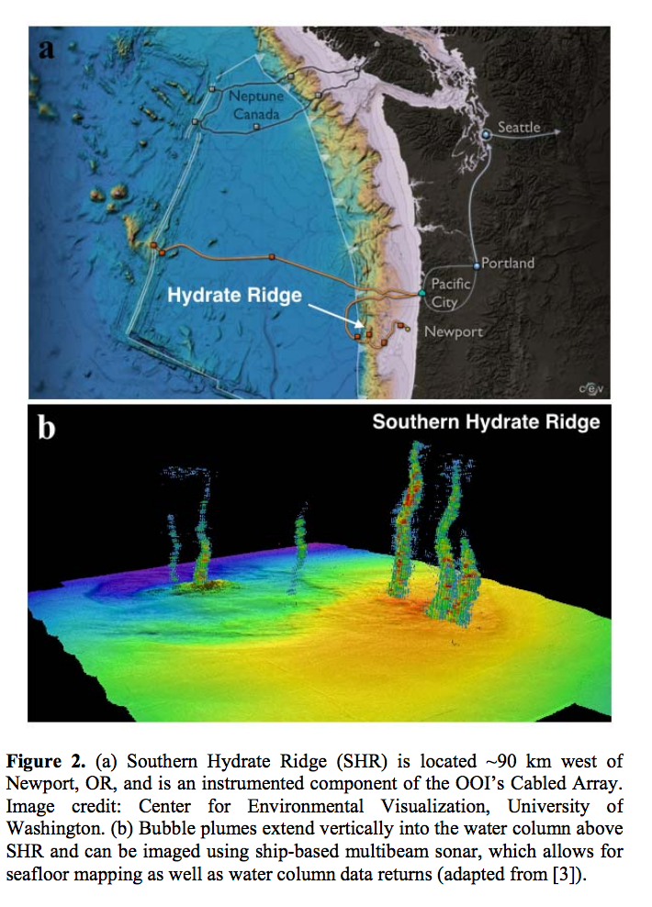
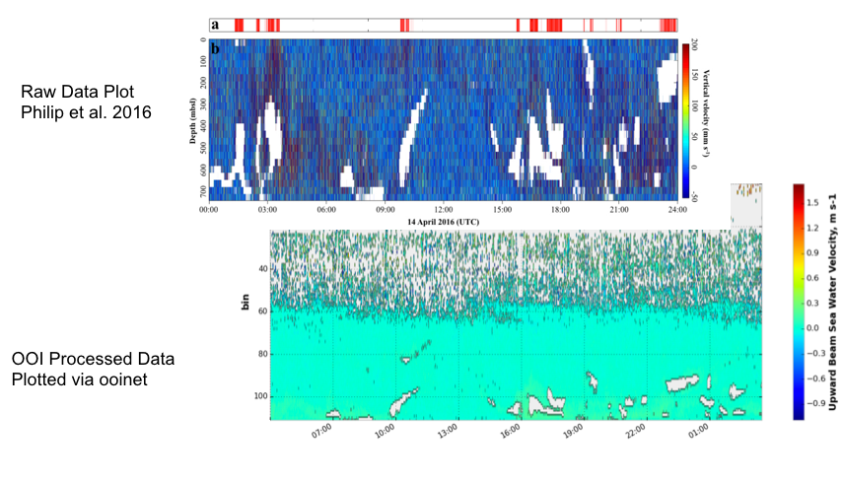
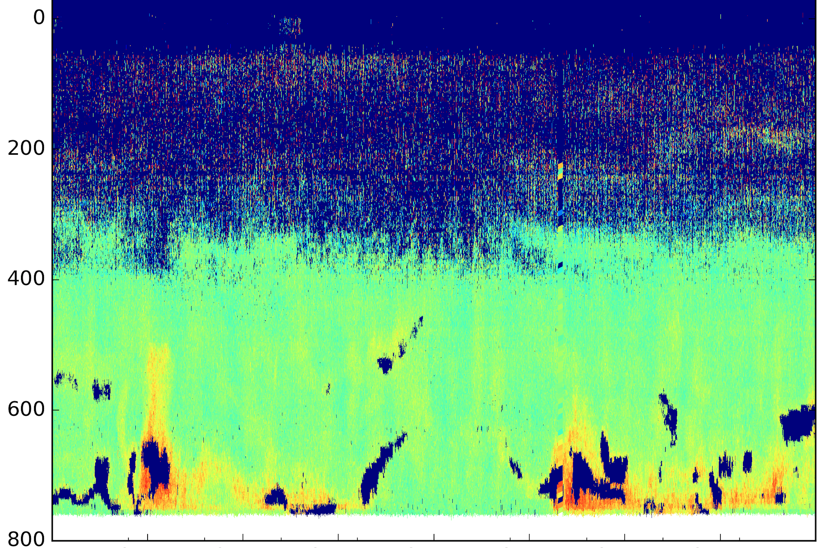

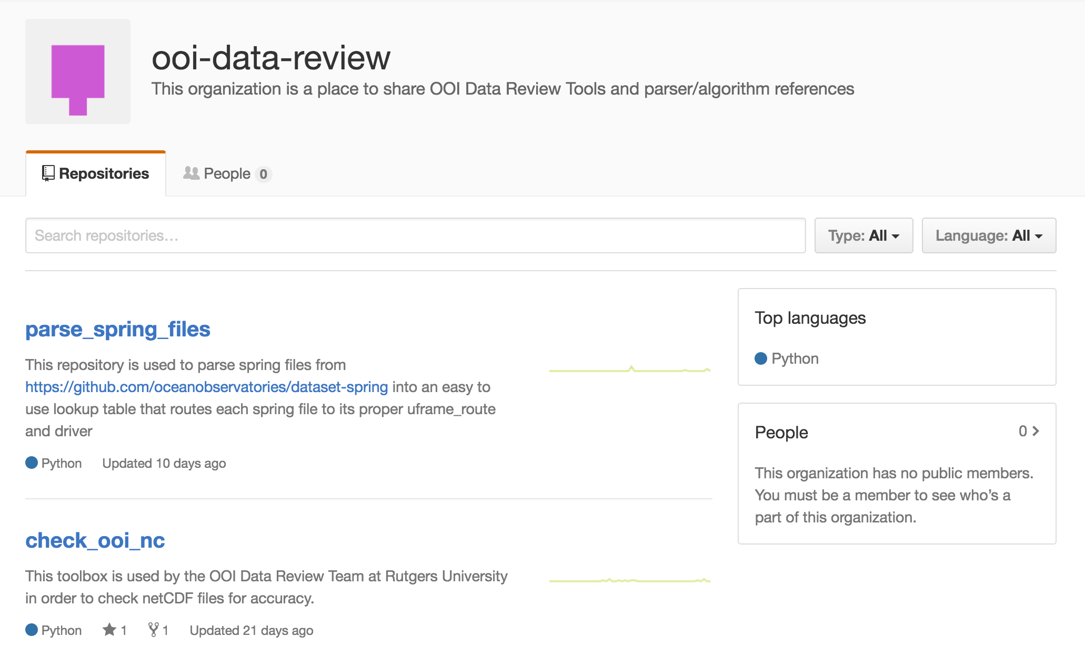
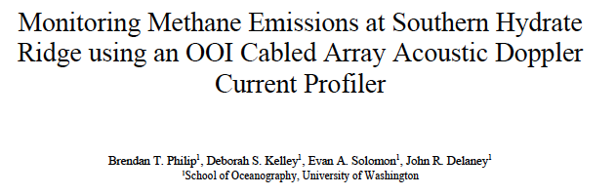
Verification of advanced science products using OOI CI
External User develops new science capability
Event detection of the bubble plumes from methane hydrate field
From outside user using downloaded OOI data
Python Plot, procedure documented in GitHub. OOI Processed Data
Downloaded via ooinet
Depth (m)
Upward Sea Water Velocity m s-1
00
03
06
09
12
15
18
21
24

Slide 12
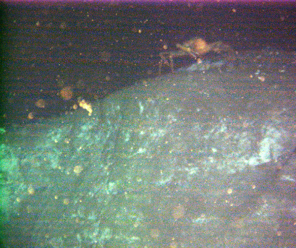
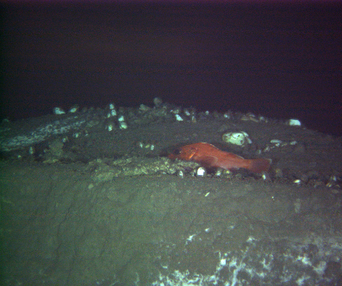
Thank you
OOI Main Web site: http://oceanobservatories.org
Data Portal: http://ooinet.oceanobservatories.org
Mike Crowley, PM, OOI CI Data Team
crowley@Rutgers.edu
Acknowledgements: NSF, COL, Rutgers U., U. Washington, WHOI, Oregon State U., Applied Science Assoc., Raytheon, U. Maine, Scripps,

